Slide 1

DS 250: Data Analysis and Visualization
District Level Healthcare Planning
&
Pregnancy Outcome Prediction
Akash Likhar - 11840110, Rhythm Gupta - 11840920, Shubham Arora - 11841080

Slide 2
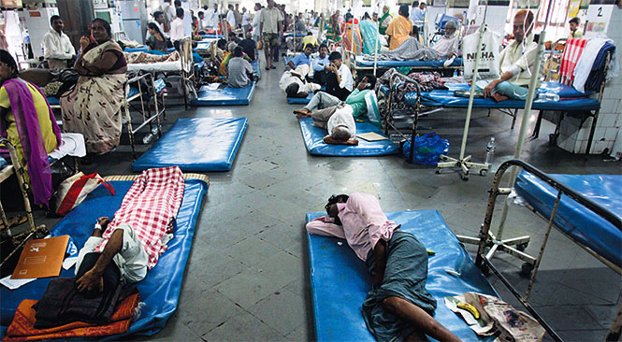
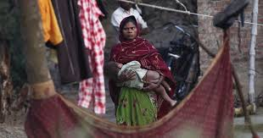
Motivation/Objective
1)Present Healthcare Situation
2) Maternal Facilities

Slide 3
Data Collection and Cleaning
Source - Health Management Information System - Ministry of Health and Family Welfare
Target State - Uttarakhand
Large file having 200+ columns
Reduced the columns to 100 after thorough analysis of each column
Separate cleaning was also done for pregnancy outcome prediction.

Slide 4
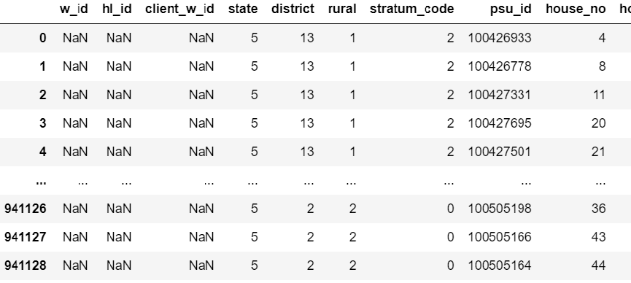
Raw Data

Slide 5
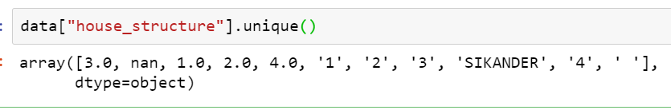
Data Cleaning - Steps
Calculated count of NaN values in each column
Try to find cause of NaN value in each column
is applicable: is_using_any_fp_method & reason_for_not_using_fp_method
not stated/not aware
others
Cleaning column one by one

Slide 6
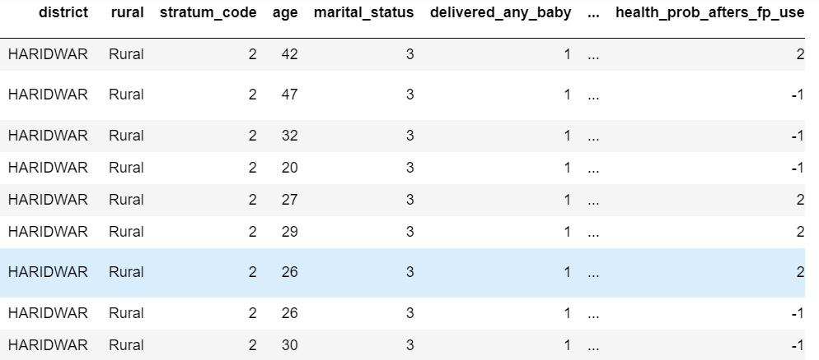
Clean Data

Slide 7
EDA
A CSV file, initially having 940k+ rows and 200+ columns
Some important information present in the dataset:
How many children were born alive and how many have survived
How many people are using birth control methods and whether they are modern methods or traditional
Modern methods - tubectomy, vasectomy, copper-T, pills etc.
Traditional methods - contraceptive herbs, periodic abstinence etc.
Number of women currently pregnant and how many of them are willing to get pregnant
How many of them are registered for Antenatal Care (ANC)
Which type of organizations are being preferred by how many people for obtaining the birth control method which they are using

Slide 8
EDA
Continued….
How many people are aware about Reproductive Tract Infections (RTI), HIV and other dangers
Qualification and occupation status
Number of people who chew, smoke or(and) drink
House structure
How many people have access to clean drinking water, proper toilets, electricity, cooking facilities etc.
How many people have basic electrical appliances and transport mediums
How many females have counselled for menstrual hygiene

Slide 9
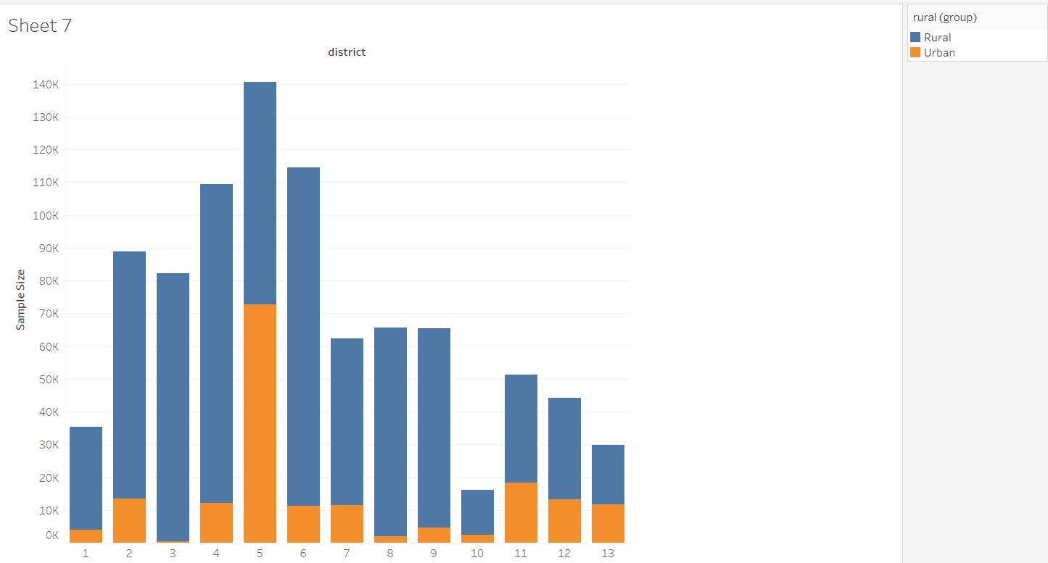
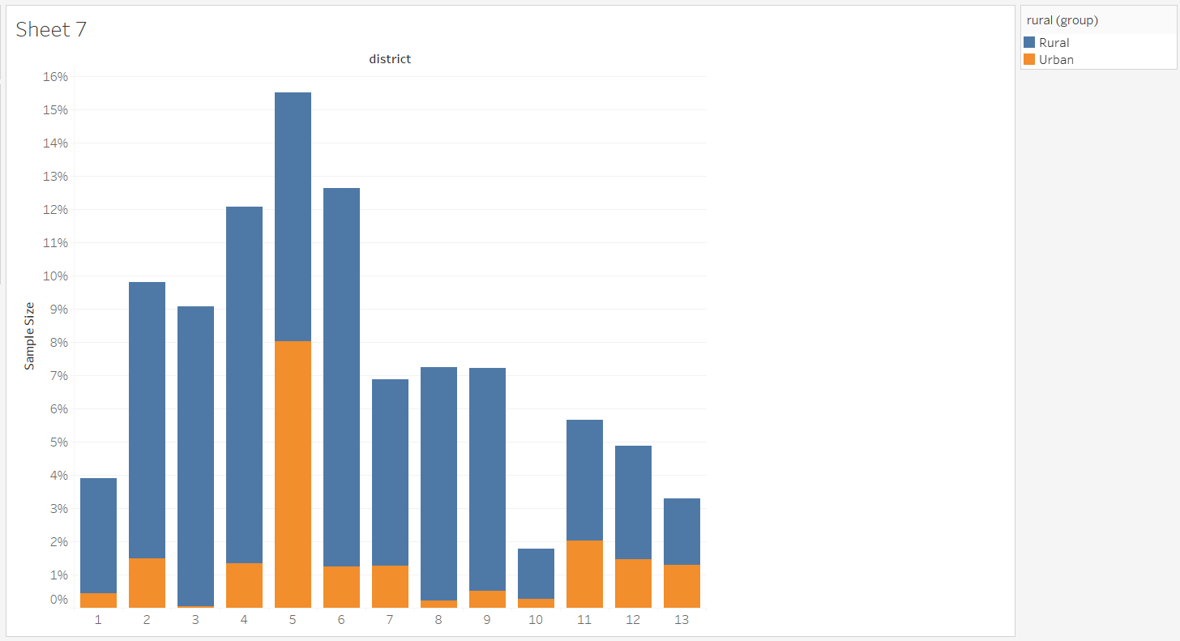
Uttrakhand Sample

Slide 10
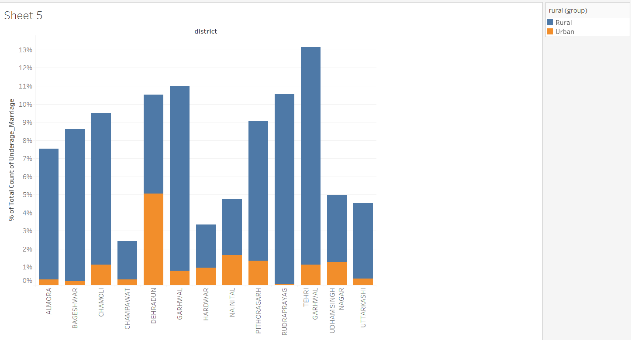
Under Age Marriage

Slide 11
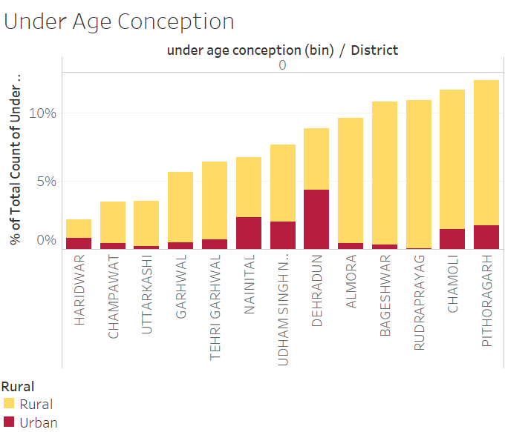
Under age conception

Slide 12
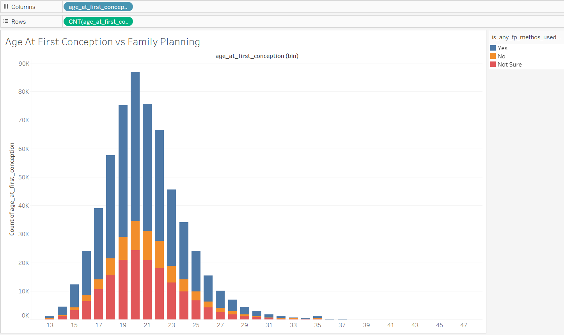
Age at first conception vs family planning

Slide 13
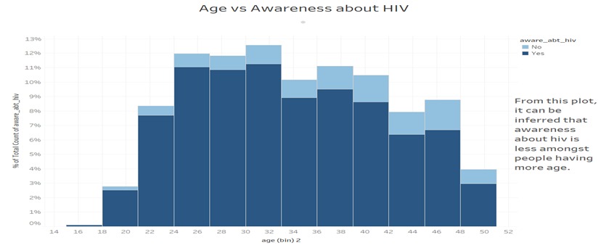
Age vs Awareness of HIV

Slide 14
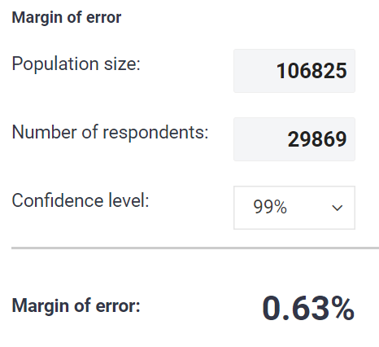
Projecting to Larger Population
Finding correct survey sample size
Margin of error
Confidence level
Margin of error for Haridwar district is
0.63% at confidence level of 99%
Link to Calculator

Slide 15
Model
•Two models have been generated for predicting outcome of pregnancy:
•LinearSVC
•Logistic Regression
•Since the dataset was very large (941131 rows), the models were trained on a fractional dataset (25000 rows) made from the initial dataset.
•Both the models gave almost same accuracy, though Logistic Regression gave slightly higher accuracy.

Slide 16
Problem Faced
Doing dimensionality reduction was one of the main problems we
faced during the project.
Most of the columns in our dataset were categorical, hence using
PCA, though it worked for us, did not turn out to be a good idea.
Data Cleaning was also a major problem because our data
contained a lot of NaN values and irrelevant columns.
But after thorough analysis of each column of the dataset, we
were able to clean it.

Slide 17
Final Results
Scoring and ranking of each district and each region (Rural/Urban)
(Score calculated and rank of each district is present in Project Report)
Pregnancy outcome prediction has been done using two models (LinearSVC and Logistic Regression), both having accuracy more than 91%.

